Slide 1

Emergency
Preparedness
Plan
STAKE: ST. CLOUD MINNESOTA STAKE
WARD: [add ward name]
MAIN CONTACT: [add name here]
DATE PREPARED: [add name here]
EMERGENCY GATHERING LOCATION:
[add place here]
SECONDARY LOCATION:
[add place here]

Slide 2
Table of Contents
SECTION 1 : EMERGENCY RESPONSE INFO
SECTION 2: STAKE EMERGENCY PROCEDURES, COMMUNICATION & ASSIGNMENTS
SECTION 3a: WARD EMERGENCY PROCEDURES, COMMUNICATION & ASSIGNMENTS
SECTION 3b: MEMBERS WITH SPECIAL NEEDS (ELDERLY OR DISABLED)
SECTION 3c: MEMBERS WITH SPECIAL EQUIPMENT OR SKILLS
SECTION 4: INDIVIDUAL AND FAMILY EMERGENCY PLAN AND RESOURCES

Slide 3
SECTION 1:
EMERGENCY
RESPONSE
PLANS

Slide 4
For the St. Cloud Minnesota Stake, the following disasters could directly affect the members of the stake:
Your ward emergency response plan should account for how to respond to each of these five situations.
SECTION 1 : EMERGENCY RESPONSE PLANS
Snowstorms and Blizzards
Wind/Rain Storm including Tornado
Fire
Flooding
Civil Unrest and Rioting
Nuclear Emergency (Monticello Power Plant)
Other (such as loss of power, natural gas, etc.)

Slide 5
Ward Instructions:
Fill out the key actions, immediate needs and resources for each of the emergencies.
Please consider what your ward will specifically need and how you can be prepared to help your members.
For key actions, think about which ward organizations will be responsible for them and can put them into actions.
For immediate needs, account for what might be needed by the members in the first 24-48 hours of an emergency.
For resources, think about what is available within the ward, within the stake and within your local communities.
SECTION 1 : EMERGENCY RESPONSE PLANS

Slide 6
1. Snowstorms and Blizzards
SECTION 1 : EMERGENCY RESPONSE PLANS
Key actions:
Immediate needs:
Resources:
What needs to happen in the first 24-48 hours?
What critical needs will the ward members have in this emergency?
What resources are available to address these needs and take key actions?

Slide 7
2. Wind/Rain Storm including Tornado
SECTION 1 : EMERGENCY RESPONSE PLANS
Key actions:
Immediate needs:
Resources:
What needs to happen in the first 24-48 hours?
What critical needs will the ward members have in this emergency?
What resources are available to address these needs and take key actions?

Slide 8
3. Fire
SECTION 1 : EMERGENCY RESPONSE PLANS
Key actions:
Immediate needs:
Resources:
What needs to happen in the first 24-48 hours?
What critical needs will the ward members have in this emergency?
What resources are available to address these needs and take key actions?

Slide 9
4. Flooding
SECTION 1 : EMERGENCY RESPONSE PLANS
Key actions:
Immediate needs:
Resources:
What needs to happen in the first 24-48 hours?
What critical needs will the ward members have in this emergency?
What resources are available to address these needs and take key actions?

Slide 10
5. Civil Unrest
SECTION 1 : EMERGENCY RESPONSE PLANS
Key actions:
Immediate needs:
Resources:
What needs to happen in the first 24-48 hours?
What critical needs will the ward members have in this emergency?
What resources are available to address these needs and take key actions?

Slide 11
6. Nuclear Emergency (Monticello Power Plant)
SECTION 1 : EMERGENCY RESPONSE PLANS
Key actions:
Immediate needs:
Resources:
What needs to happen in the first 24-48 hours?
What critical needs will the ward members have in this emergency?
What resources are available to address these needs and take key actions?

Slide 12
7. Other (such as loss of power, natural gas, etc.)
SECTION 1 : EMERGENCY RESPONSE PLANS
Key actions:
Immediate needs:
Resources:
What needs to happen in the first 24-48 hours?
What critical needs will the ward members have in this emergency?
What resources are available to address these needs and take key actions?

Slide 13
SECTION 2: STAKE
EMERGENCY PROCEDURES, COMMUNICATION
& ASSIGNMENTS

Slide 14
Stake Instructions:
The St. Cloud Stake is a valuable resources during and after an emergency. Members of the stake presidency, stake council and stake organizations are available to aid in emergency situations. This section will provide contact information for key stake roles related to emergency preparedness.
Reporting: During an emergency, the stake presidency receives reports from bishops/branch presidents and/or elders Quorum Presidents and Relief Society Presidents on the condition of Church members, the missionaries, and Church property.
The stake presidency then reports to a member of the Presidency of the Seventy or the Area Presidency.
Resource allocation: During an emergency, the stake counsel make the services of the Church available to civil authorities. Church leaders also take independent action in behalf of Church members as needed.
With approval from a member of the Presidency of the Seventy or the Area Presidency, church buildings may be used as shelters, first-aid stations, feeding locations, and recreation centers during emergencies. Stake and ward council members ensure that those using the buildings observe Church standards of conduct, including the Word of Wisdom, while they are in the buildings.
Communications: During an emergency, the stake president oversees public information that is released locally by the Church. The stake president reviews and approves all news releases given by the spokesperson. He also gives proper recognition to civil authorities and relief agencies.
SECTION 2 : Stake Emergency Procedures, Communication & Assignments

Slide 15
Units and the Stake should promote individual preparedness. Most emergencies occur in the home. Immediate emergency response starts with the family (seconds), followed by emergency responders such as fire, paramedics, or police (minutes). Then neighbors and the ward/branch follow with support (minutes to hours). The stake response will take more time.
During emergencies, wards/branches activate their emergency plans. The bishop/branch president or elder quorum president reports to the stake presidency the condition of the unit’s members, missionaries and church building. The unit leaders request any needed assistance. This may be equipment, supplies, number of volunteers needed and locations.
In disasters, the units and stake will coordinate relief efforts. Because the St. Cloud stake is large and spread out, most disasters will be contained within a single unit or adjacent units. Wards or Branches should assess the needs and report to the stake if there are additional needs. The stake will muster support by reaching out to unaffected units or area leaders if needed.
The units emergency plans will speed up the stakes response. The units emergency assessment is key information for the stakes response.
SECTION 2 : Stake Emergency Procedures, Communication & Assignments

Slide 16
SECTION 3a: WARD
EMERGENCY PROCEDURES, COMMUNICATION & ASSIGNMENTS

Slide 17
Section 3a: EMERGENCY QUICK REFERENCE: [add ward name]
WARD EMERGENCY CONTACTS
MINISTERING
BISHOPRIC
NAME | PHONE
Bishop [add name] | (000) 000-0000 | name@email.com
Br. [add name] | (000) 000-0000 | name@email.com
Br. [add name] | (000) 000-0000 | name@email.com
Exec. Secretary | (000) 000-0000 | name@email.com
WARD EMERGENCY GATHERING LOCATIONS
RELIEF SOCIETY
Gathering Location: | [add primary location]
 | [add primary location address]
Sis. [add name] | (000) 000-0000 | name@email.com
Sis. [add name] | (000) 000-0000 | name@email.com
Sis. [add name] | (000) 000-0000 | name@email.com
RS Secretary | (000) 000-0000 | name@email.com
Gathering Location: | [add primary location]
 | [add primary location address]
ELDERS QUORUM
OTHER FAMILY EMERGENCY CONTACTS
Br. [add name] | (000) 000-0000 | name@email.com
Br. [add name] | (000) 000-0000 | name@email.com
Br. [add name] | (000) 000-0000 | name@email.com
EQ Secretary | (000) 000-0000 | name@email.com
NAME | PHONE

Slide 18
Ward Instructions:
When an emergency hits it will be important to have procedures in place to get help and resources to members of the ward. A clear communication chain will help to check on and account for your ward members. Having a clearly understood communication procedure will help with minimizing confusion and losing track of members in an emergency.
In the following section, include:
General emergency procedures
  How and when any emergency protocols/plans are enacted
  Key leaders in those decisions
  Ward emergency coordinator contact info
Communication chain
  The Elders Quorum presidency and the Relief Society presidency should be at the top of the chain
  Consider how to utilize ward Ministering assignments for contacting ward members
  Plan for updating ward contact info annually (i.e. for example during annually tithing settlements)
List of assignments
  Who is in charge or which protocols/procedures
  Consider back ups for essential assignments (in case the first person is unavailable or directly effected by the emergency)
SECTION 3a : EMERGENCY PROCEDURES, COMMUNICATION & ASSIGNMENTS

Slide 19
General Emergency Procedures
SECTION 3a: EMERGENCY PROCEDURES, COMMUNICATION & ASSIGNMENTS
Key Information | Ward Emergency Procedures
How and when any emergency protocols/plans are enacted
Key leaders in those decisions
Ward emergency coordinator contact info

Slide 20
Communication Chain
Emergency Communication Methods:
a. Internet communications (including email, social media, and internet telephone).
b. Text messaging via cellular phone (which may be available even if voice service is not).
c. Amateur radio.
Member Name – Ward
Member Name - Ward
Member Name - Ward
Member Name – Ward d. Personal contact via foot, bicycle, etc.
SECTION 3a: EMERGENCY PROCEDURES, COMMUNICATION & ASSIGNMENTS

Slide 21
List of Assignments
SECTION 3a: EMERGENCY PROCEDURES, COMMUNICATION & ASSIGNMENTS
NAME (FIRST LAST) | ASSIGNMENT | TELEPHONE | EMAIL

Slide 22
SECTION 3b:
MEMBERS WITH SPECIAL NEEDS
(ELDERLY OR DISABLED)

Slide 23
Special Needs
SECTION 3b: MEMBERS WITH SPECIAL NEEDS (ELDERLY OR DISABLED)
NAME (FIRST LAST) | SPECIAL NEED | TELEPHONE | ADDRESS | EMERGENCY HELPER | TELEPHONE

Slide 24
SECTION 3c:
MEMBERS
WITH SPECIAL EQUIPMENT
OR SKILLS

Slide 25
Special Equipment
SECTION 3c: MEMBERS WITH SPECIAL EQUIPMENT OR SKILLS
SPECIAL EQUIPMENT OR SKILLS | EMERGENCY TYPE | NAME (FIRST LAST) | TELEPHONE | EMAIL

Slide 26
SECTION 4:
INDIVIDUAL AND FAMILY EMERGENCY
RESPONSE
PLANS
*contents taken from the Temporal Preparedness Guide North America Central Area Guide

Slide 27
Emergency Planning Guidelines
SECTION 4: Individual and Family Emergency Preparedness Plan
Introduction:
God has promised, "If ye are prepared ye shall not fear" (Doctrine and Covenants 38:30). When we have plans in place, we are more prepared for challenges. This includes:
  • Emergency planning
  • Home storage and production
  • Financial preparedness
  • Emotional preparedness.
Like spiritual learning, preparedness is best done “line upon line” (Isaiah 28:10). And when challenges occur, we can learn from them, heal and grow, and continue to prepare.
Elements of an Emergency Plan:
Start by learning about the disasters that could happen where you live. Then prepare your home. Make an emergency kit. Create a plan for communicating and gathering during a disaster.

Slide 28
Preparing Your Home for Emergencies
SECTION 4: Individual and Family Emergency Preparedness Plan
General Preparation
There are many things you can do to prepare your home for potential emergencies. Consider the following:
Utility Shut-Off
Locate the shut-off valves and levers for utilities. Know how to turn off the water, electricity, and natural gas lines inside and outside your home.
Food, Water, and Non-food Essentials Home Storage
A store of food, water, and non-food essentials can help when emergencies disrupt our daily lives. Consider taking the following steps (additional details within Area Temporal Preparedness Guide: North America Central(pdf)):
Store an emergency supply of nonrefrigerated foods.
Plan on one gallon of water per person per day for drinking, food preparation, and sanitation. Store enough water for three days.
Store medical supplies, clothing, blankets, flashlights, extra batteries, sanitation supplies, and so on.

Slide 29
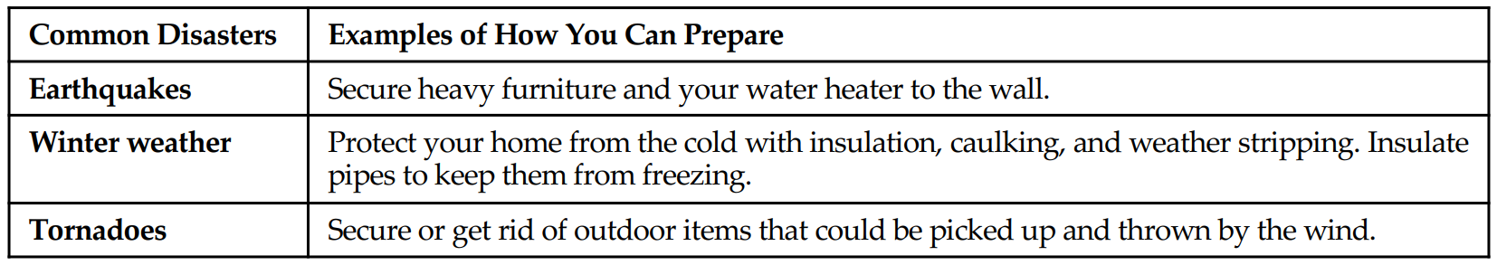
Preparing Your Home for Emergencies
SECTION 4: Individual and Family Emergency Preparedness Plan
Cooking Solutions
An alternative cooking source allows you to prepare hot meals. Make sure to cook only in well-ventilated areas.
Cooking sources can be:
Canned heat or candle warmers (used under serving dishes or fondue pots).
A wood-burning cook stove.
A fireplace.
Grills or camp stoves (use outdoors only).
Emergency Kit
Create an emergency kit for your home, vehicle, and place of work (see page 6).
Preparing for Specific Disasters
Consider what disasters are common for your area and prepare for those emergencies. Here are some examples:

Slide 30
Preparing an Emergency Kit
SECTION 4: Individual and Family Emergency Preparedness Plan
An emergency kit can help you be prepared if you need to leave your home quickly or if you need to survive for a short period of time. Having a kit ready will help bring peace to your mind. When making a kit, consider:
Additional Resources
Your local county and city are great sources of information on emergency planning. You can find more about this topic at the sites listed below:
  ready.gov
  emergency.cdc.gov
  fema.gov
  redcross.org/get-help/how-to-prepare-for-emergencies.html
  savethechildren.org/us/what-we-do/us-programs/disaster-relief-in-america

Slide 31
Disaster and Disruption Assessment Activity
SECTION 4: Individual and Family Emergency Preparedness Plan
“Let all things be prepared before you” (Doctrine and Covenants 101:68)
Learn about Disasters
Answer the questions below to help you identify the most common disasters and disruptions where you live. This will help you know what to plan for.
What disasters are most common where you live? List them below (for example, tornadoes, floods, severe winter
weather, and so on).
What area of my life will they disrupt? Describe your answer below. (For example, a tornado could disrupt the
power. I could be without heat and without the ability to use my stove and charge my phone.)
Refer to the “Planning for Disruptions” activity on next slide to make a plan for these disruptions.

Slide 32
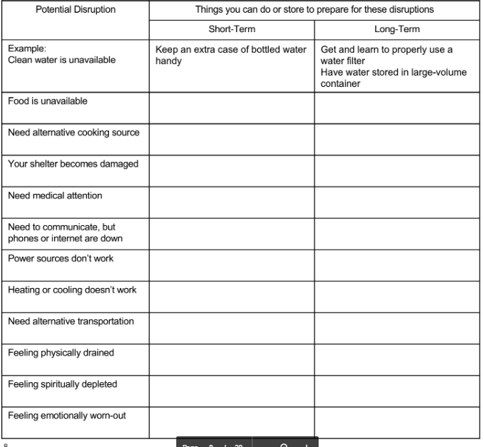
Planning for Disruptions Activity
SECTION 4: Individual and Family Emergency Preparedness Plan
“If ye are prepared ye shall not fear” (Doctrine and Covenants 38:30).
Planning for Disruptions
Use this worksheet to plan for needs you could have after a disaster.
Identify the things you can do or store to prepare for these disruptions.

Slide 33
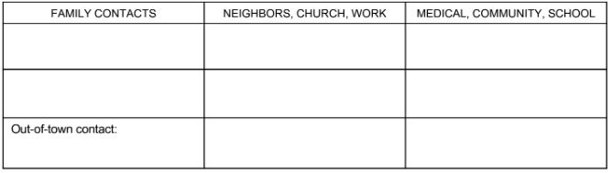
Communication Plan Activity
SECTION 4: Individual and Family Emergency Preparedness Plan
“Be thou prepared, and prepare for thyself, thou, and all thy company that are assembled unto thee, and be thou a guard unto them” (Ezekiel 38:7).
Create a plan for contacting people in an emergency. You might:
  • Make a list of emergency contacts. Include family members, friends, neighbors, Church leaders, and community resources.
  • Memorize key phone numbers in case your contact list is unavailable.
  • Plan other ways to make contact if you can’t make a phone call. This might mean texting, instant messaging, or posting on social media.
  • Choose a relative in another city to be an out-of-town contact. Plan for all family members to contact that person. They can tell their condition and location to the out-of-town contact. The out-of-town contact can pass information between family members.
  • Update your information in the Church’s Member Tools app so leaders and others can reach you in an emergency.
  • Complete the form below so you have this information handy in an emergency.

Slide 34
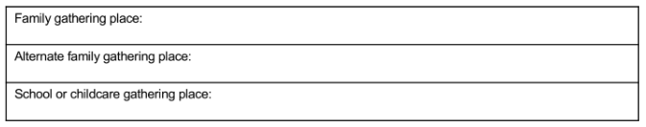
Gathering Plan Activity
SECTION 4: Individual and Family Emergency Preparedness Plan
Pick a safe place where you and your family can find each other after an emergency. It is also a good idea to choose an alternate place. Gathering places may change depending on the disaster or where you are when the disaster happens. For example, if you’re at school, you may not be able to go to the safe place near your home. Your gathering place should be somewhere where children can find a trusted adult.

Slide 35
Preparing for an Emergency Checklist
SECTION 4: Individual and Family Emergency Preparedness Plan
“And see that all these things are done in wisdom and order” (Mosiah 4:27).
Emergency Planning Checklist
This checklist can help you review what you need to do to become more prepared. Go through the list and check off the items you have. Then work to gather what you still need and write down things you need to do.
Once you have everything on your checklist, don’t forget to check your emergency supplies regularly. Children grow out of clothes, food expires, and plans change. Revisit this list often and see what needs to be replaced or added. Add any action items below to help you complete your checklist.

Slide 36
Preparing for an Emergency Checklist
SECTION 4: Individual and Family Emergency Preparedness Plan
Food and Water
Supply of perishable food for ____ days
____ gallons of water per individual
Cooking source
____________________________ (Add your own)
____________________________ (Add your own)
Emergency Kit
Clothing
Blankets
Medical supplies
Light source
Critical documents (identification, financial, etc.)
Communication method
Communication and gathering plan
____________________________ (Add your own)
____________________________ (Add your own)
Home Preparation
Knowledge of how to shut off home utilities (gas, water, and electricity)
_____________________________(Add your own)
ACTION ITEMS
__________________________________________________
__________________________________________________
__________________________________________________
__________________________________________________
__________________________________________________
__________________________________________________
__________________________________________________

